Slide 1
IT302 Internet Technology
Module I

Slide 2
Introduction to Computers and the Internet
Moore’s Law
Every year or two, the capacities of computers have approximately doubled inexpensively.

Slide 3
The Internet in Industry and Research
In health care
Electronic health records
Human Genome Project
In social good
AMBER™ Alert – s/m to find abducted children
World Community Grid – u can donate ur unused processing power by installing a small s/w
One Laptop Per Child (OLPC) – providing low power inexpensive laptops to poor.

Slide 4
In Infrastructure
Cloud computing
GPS
Robots
E-mail, Instant Messaging, Video Chat and FTP
In entertainment
iTunes and the App Store
Internet TV
Game programming

Slide 5
HTML5, CSS3, JavaScript, Canvas and jQuery
HTML 5 : specify the content and structure of web pages in a portable manner.
Cascading Style Sheets (CSS) : to specify the presentation, or styling, of elements on a web page
JavaScript : to build dynamic web pages
Canvas : javascript API to draw 2D objects
jQuery : provides a library of custom GUI controls that can be used to enhance the look and feel of your web pages.

Slide 6
Evolution of the Internet and World Wide Web
ARPANET
Packet Switching
TCP/IP

Slide 7
Language of web page
- HTML (Hypertext Markup Language)

Slide 8

Identify the personality !!!
Inventor of the WWW Implemented the first successful communication between an HTTP client and server via the internet Director of the W3C),

Slide 9
Web Basics
The fundamentals of web-based interactions between a client web browser and a web server.
web page
HTML (HyperText Markup Language) document (with the extension .html or .htm) that describes to a web browser the document’s content and structure.
Hyperlinks
HTML documents normally contain hyperlinks, which, when clicked, load a specified web document.
Both images and text may be hyperlinked.
When the user clicks a hyperlink, a web server locates the requested web page and sends it to the user’s web browser.

Slide 10
URIs and URLs-
URIs that start with http:// are called URLs (Uniform Resource Locators).
Common URLs refer to files, directories or server-side code that performs tasks such as database lookups, Internet searches and business-application processing.

Slide 11
Parts of a URL
A URL contains information that directs a browser to the resource that the user wishes to access.
Eg: http://www.deitel.com/books/downloads.html
http:// indicates that the HyperText Transfer Protocol (HTTP) should be used to obtain the resource.
hostname (for eg: www.deitel.com)-name of the web-server computer on which the resource resides.
This computer is referred to as the host, because it houses and maintains resources.

Slide 12
The hostname www.deitel.com is translated into an IP (Internet Protocol) address—a numerical value that uniquely identifies the server on the Internet.
An Internet Domain Name System (DNS) server maintains a database of hostnames and their corresponding IP addresses and performs the translations automatically

Slide 13
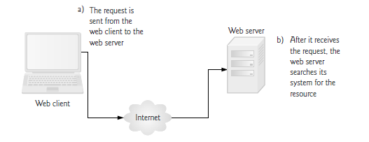
Request
Fig: Client requesting a resource from a web server

Slide 14
The request will be of the form
GET /books/downloads.html HTTP/1.1
The word GET is an HTTP method indicating that the client wishes to obtain a resource from the server.
The remainder of the request provides the path name of the resource (e.g., an HTML5 document) and the protocol’s name and version number (HTTP/1.1). The client’s request also contains some required and optional headers.

Slide 15
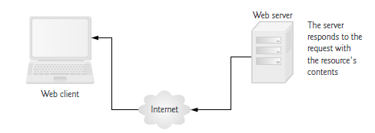
Response

Slide 16
Response …
The server first sends a line of text that indicates the HTTP version, followed by a numeric code and a phrase describing the status of the transaction.
HTTP/1.1 200 OK-
indicates success,
HTTP/1.1 404 Not found
informs the client that the web server could not locate the requested resource

Slide 17
HTTP Headers
The server sends one or more HTTP headers, which provide additional information about the data that will be sent.
In this case, the server is sending an HTML5 text document, so one HTTP header
Eg:Content-type: text/html, text/plain, image/jpeg
The information provided in this header specifies the Multipurpose Internet Mail Extensions (MIME) type of the content that the server is transmitting to the browser.

Slide 18
HTTP Headers …
The MIME standard specifies data formats, which programs can use to interpret data correctly.
The MIME type text/plain indicates that the sent information is text that can be displayed directly.
MIME type image/jpeg indicates that the content is a JPEG image.

Slide 19
HTTP get and post Requests
The two most common HTTP request types (also known as request methods) are get and post.
A get request typically gets (or retrieves) information from a server, such as an HTML document, an image or search results based on a user-submitted search term.
A post request typically posts (or sends) data to a server.

Slide 20
Client-Side Caching
Browsers often cache (save on disk) recently viewed web pages for quick reloading.
If there are no changes between the version stored in the cache and the current version on the web, this speeds up your browsing experience.

Slide 21
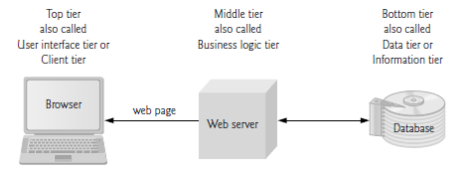
Multitier Application Architecture

Slide 22
Client-Side Scripting versus Server-Side Scripting
Client-side scripting with JavaScript can be used to validate user input,
server-side scripts - often generate custom responses for clients.

Slide 23
What is HTML
HTML describes the content and format of web pages using tags.
Ex. Title Tag: <title>A title </title>
It’s the job of the web browser to interpret tags and display the content accordingly.

Slide 24
HTML Syntax
An HTML file contains both formatting tags and content
Document content is what we see on the webpage.
Tags are the HTML codes that control the appearance of the document content.

Slide 25
HTML Syntax
HTML syntax:
two-sided tag:
<tag attributes>document content</tag>
Closing tag
Starting tag
Properties of the tag.
Optional!
Actual content appears in webpage. It could be empty
Examples: <p> CGS 2100 </p>
<body bgcolor = “yellow”> UCF </body>

Slide 26
HTML Syntax
comments start with <!-- and end with -->

Slide 27
Structure of the web page
Starting with the tag <html>...</html>
<html>
.......
</html>
Everything about the web page should be enclosed here

Slide 28
Structure of the web page
Inside the <html></html> tag
Each web page has a head part described in <head></head> tag:
<html>
<head>
<title> CGS 2100 </title>
</head>
</html>
The title of the web page should be put here

Slide 29
Head Section
Information about the
Character set(UTF-8, the most popular character-encoding scheme for the web) which helps the browser determine how to render the content.
the title(nested element)
can contain special document-formatting instructions called CSS style sheets

Slide 30
Structure of the web page
Inside the <html></html> tag
Each web page has a body part described in <body></body> tag:
<html>
<head>
<title> CGS 2100 </title>
</head>
<body>
This is a sample HTML file.
</body>
</html>
The content of the whole web page should be put here

Slide 31
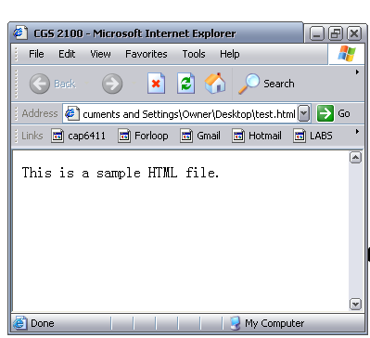
Title
Body

Slide 32
Create a basic HTML file
Open your text editor (notepad).
Type the following lines of code into the document:
<html>
<head>
<title> CGS2100 lab section</title>
</head>
<body>
This is a sample HTML file.
</body>
</html>

Slide 33
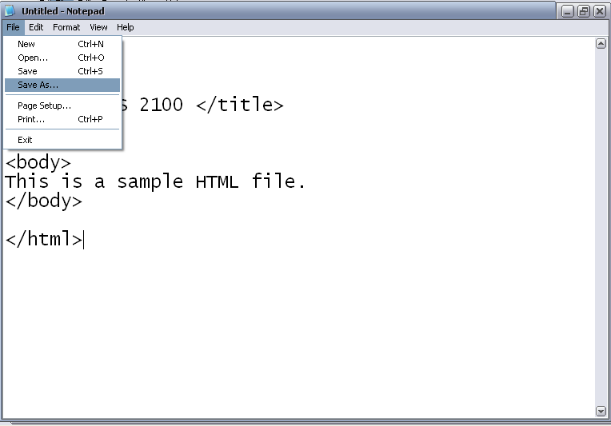
Create a basic HTML file (cont)
Save the file as sample.htm

Slide 34
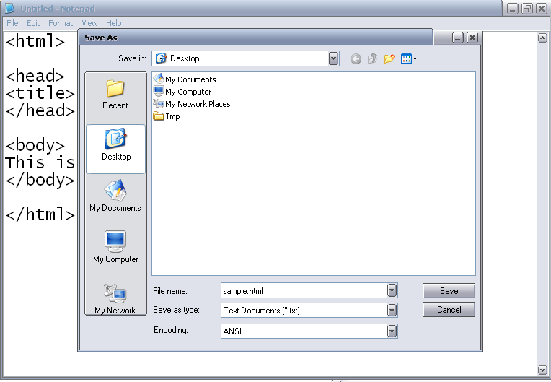
sample.html

Slide 35
Introduction to some common tags
Headings
Paragraph tag-<p> …..</p>
define the structure of a document.
List tag
Hyperlink tags

Slide 36
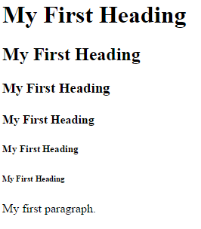
Heading
six heading tags(h1 to h6)
for specifying the relative importance of information.
<html>
<head>
<title>Page Title</title>
</head>
<body>
<h1>My First Heading</h1>
<h2>My First Heading</h2>
<h3>My First Heading</h3>
<h4>My First Heading</h4>
<h5>My First Heading</h5>
<h6>My First Heading</h6>
<p>My first paragraph.</p>
</body>
</html>

Slide 37

Linking - hyperlink
Link to another location or file
Syntax:
<a href= “http://www.ucf.edu”> Link to UCF </a>
Content displayed on the page
Starting Tag
Attribute of the tag: the address of the hyperlink
Ending tag
Result:

Slide 38
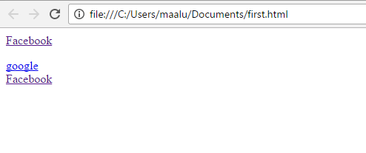
Hyperlink
<html>
<head>
<title>Page Title</title>
</head>
<body>
<p><a href = "http://www.facebook.com">Facebook</a></p>
<a href = "http://www.google.com">google</a>
<a href = "http://www.facebook.com">Facebook</a>
</body>
</html>

Slide 39
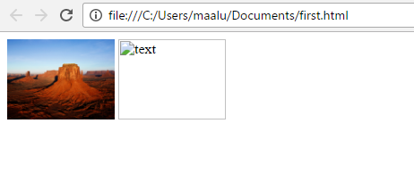
Images
<img src=“FILENAME” />
<img src=“FILENAME” alt=“text” />
E.g.
<html>
<head>
<title>Page Title</title>
</head>
<body>
<img src ="Desert.jpg" height="90" width="120" alt="text">
<img src ="Deset.jpg" height="90" width="120" alt="text">
</body>
</html>

Slide 40
Images
alt Attribute
Void Elements
Using Images as Hyperlinks
<a href = "list.html">
<img src = "buttons/list.jpg" width = "65"
height = "50" alt = "List of Features">
</a>

Slide 41
Paragraph tags <p>...</p>
<html>
<head>
<title> CGS 2100 </title>
</head>
<body>
<p> Here is the first paragraph. </p>
<p> Here is the second paragraph. </p>
</body>
</html>

Slide 42
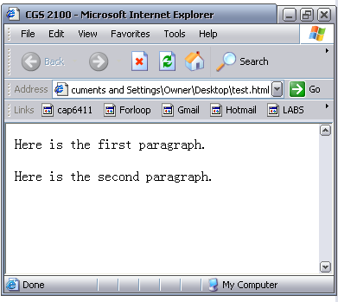
result
First paragraph
Space between paragraphs
Second paragraph

Slide 43
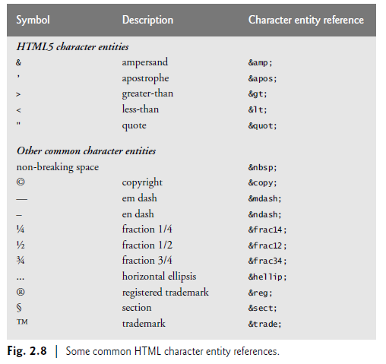
Special Characters and Horizontal Rules

Slide 44
Horizontal Rules ...
horline.htm

Slide 45

List tags
Ordered list: used to display information in a numeric order. The syntax for creating an ordered list is:
<ol > e.g. <ol >
<li>item1 </li> <li> Name: Your name </li>
<li>item2 </li> <li> Section: ### </li>
… <li> Instructor: Yuping </li>
</ol> </ol>
Result:

Slide 46

List tags
Unordered list: list items are not listed in a particular order. The syntax is:
<ul > e.g. <ul>
<li>item1 </li> <li> Name: Your name </li>
<li>item2 </li> <li> Section: ### </li>
… <li> Instructor: Yuping </li>
</ul> </ul>
Result

Slide 47
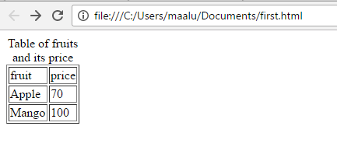
Table
<html>
<head>
<title>Page Title</title>
</head>
<body>
<table border="1">
<caption> Table of fruits and its price </caption>
<thead>
<tr>
<td> fruit </td>
<td> price </td>
</tr>
</thead>
<tr> <td> Apple </td>
<td> 70 </td> </tr>
<tr>
<td> Mango </td>
<td> 100 </td>
</tr>
</table> </body> </html>

Slide 48
Forms
When browsing websites, users often need to provide information such as search queries, e-mail addresses and zip codes. HTML5 provides a mechanism, called a form, for collecting data from a user.
Data that users enter on a web page is normally sent to a web server that provides access to a site’s resources

Slide 49
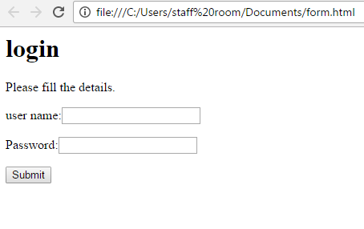

Slide 50
Form
<form method = "post" action = "http://www.facebook.com">
Attribute method specifies how the form’s data is sent to the web server.
Method=“get” (appends the form data directly to the end of the URL of the script, where it’s visible in the browser’s Address field).
Method=“post”(appends form data to the browser request, which contains the protocol (HTTP) and the requested resource’s URL
the user doesn’t see the data after the form is submitted.

Slide 51
Forms
Action-The action attribute in the form element specifies the URL of a script on the web server that will be invoked to process the form’s data.
Input-input elements that specify data to provide to the script that processes the form.
An input’s type is determined by its type attribute
form uses different types of input such as text input, a submit input, reset input etc.

Slide 52
Text input Element
The text input inserts a text field in the form.
Users can type data in text fields.
The label element provides users with information about the input element’s purpose.
The input element’s size attribute specifies the number of characters visible in the text field.
Optional attribute maxlength limits the number of characters input into the text field—in this case, the user is not permitted to type more than 30 characters

Slide 53
Submit and Reset input Elements
The submit input element is a button.
When the submit button is pressed, the form’s data is sent to the location specified in the form’s action attribute.
The value attribute sets the text displayed on the button.
The reset input element allows a user to reset all form elements to their default values.

Slide 54
Additional Form tags
Textarea- insert multiple text areas into the form.
<textarea rows="5" cols="80">Enter comments here </textarea>
Checkbox-enable users to select an option.
When a user selects a checkbox, a check mark appears in the checkbox.
Otherwise,the checkbox remains empty
<input type="checkbox" name="name">

Slide 55
Form tags
Radio button-
<input type="radio" name="name">
Dropdown list-
Select element provides a dropdown list from which user can select an item.
Option element adds items into the list.
<select name="rating" >
<option selected> 1</option>
<option> 2</option>

Slide 56
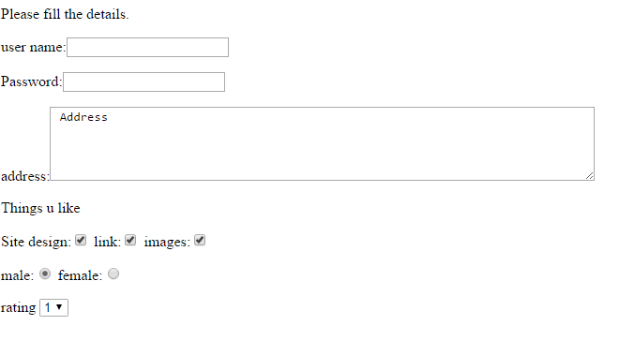

Slide 57
Internal Linking
Internal linking—a mechanism that enables the user to jump between locations in the same document.
Internal linking is useful for long documents that contain many sections.
Clicking an internal link enables the user to find a section without scrolling through the entire document.

Slide 58
meta Elements
Search engines catalog sites by following links from page to and saving identification and classification information for each page.
One way that search engines catalog pages is by reading the content in each page’s meta elements, which specify information about a document.
The meta element is one of many methods of search engine optimization (SEO)—the process of designing and tuning your website to maximize your findability and improve your rankings in organic search engine results.

Slide 59
meta Elements
Search engines catalog sites by following links from page to page (often known as spidering or crawling the site)
One way that search engines catalog pages is by reading the content in each page’s meta elements
Two important attributes of the meta element are
Name
content
Name-which identifies the type of meta element
content- which provides the information search engines use to catalog pages.
Eg: <meta name = "keywords" content = "web page, design, HTML5, tutorial, personal, help, index, form, contact, feedback, list, links, deitel">
The content attribute keyword meta element provides search engines with a list of words that describe the page
These words are compared with words in search requests.

Slide 60
New HTML5 Form input Types
<input type=“color” autofocus/>
enable users to enter color
Autofocus- it specifies that an <input> element should automatically get focus when the page loads.

Slide 61
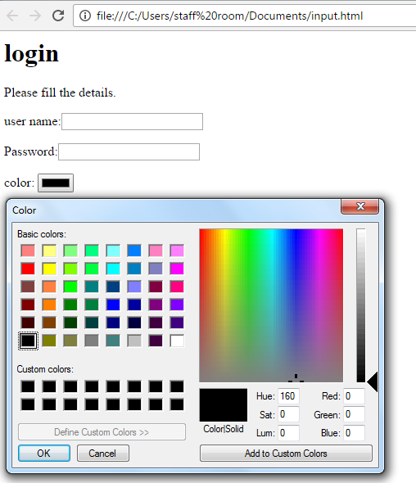

Slide 62
<input type="datetime" />
<input type="datetime-local”/>
<input type=“month”/>
<input type=“time”/>
<input type=“week”/>

Slide 63
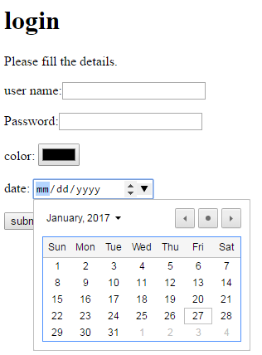
<input type="date" />

Slide 64
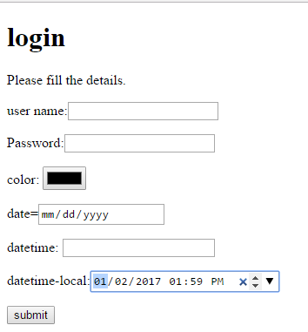

Slide 65
<input type="email” placeholder="name@gmail.com" required/>
<input type="number" min="0" max="10" step="2" value="2">
0<input type="range" min="0" max="20" value="6"/>20

Slide 66
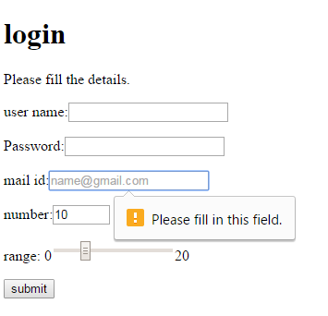

Slide 67
<input type=“url” />

Slide 68
Autocomplete & Datalist
Autocomplete-Used to fill the users information based on previous input such as name, address, email.
We enable autocomplete for an entire form or just for specific elements.
<lable> user name:<input type="text" maxlength=25 autocomplete="on"</label>

Slide 69
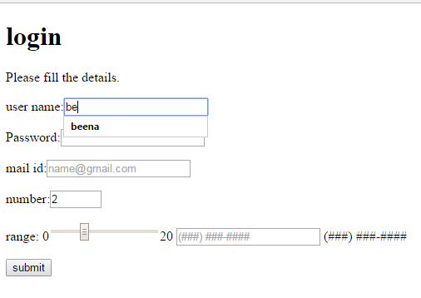

Slide 70
Datalist
Datalist-Provides an option for text input element
The <datalist> tag is used to provide an "autocomplete" feature on <input> elements.
Users will see a drop-down list of pre-defined options as they input data.
<input type = "text" placeholder = "Select a month" list = "months" />
<datalist id = "months">
<option value = "January">
<option value = "February">
<option value = "March">
<option value = "April">
</datalist>

Slide 71
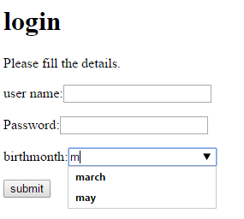

Slide 72
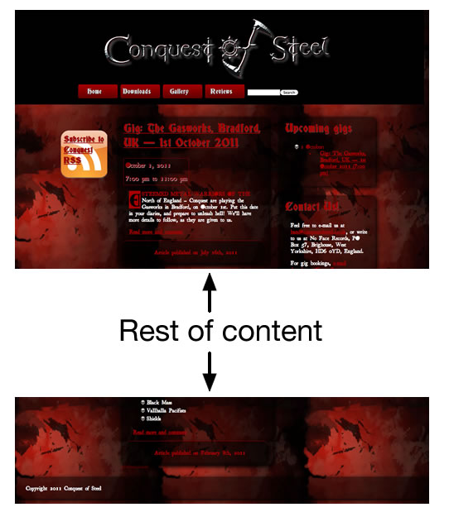
Page structure

Slide 73
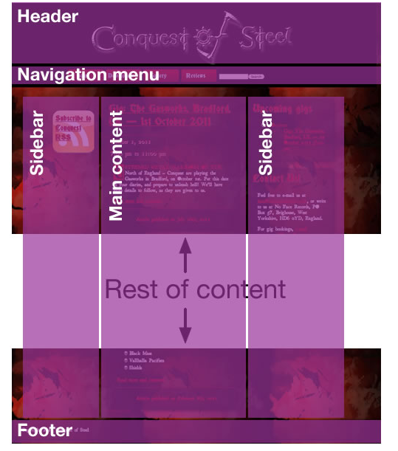

Slide 74
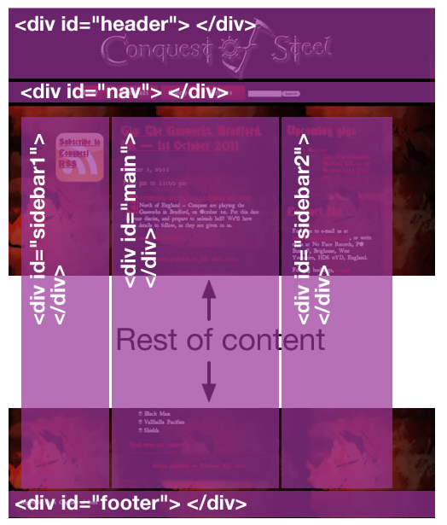

Slide 75
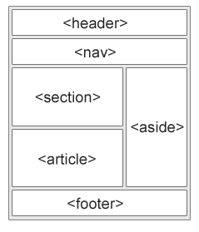
Page structure elements

Slide 76
Page structure elements
<header> - Defines a header for a document or a section
<nav> - Defines a container for navigation links
<section> - Defines a section in a document
<article> - Defines an independent self-contained article
<aside> - Defines content aside from the content (like a sidebar)
<footer> - Defines a footer for a document or a section
<details> - Defines additional details
<summary> - Defines a heading for the <details> element

